Slide 1

Başlık Düzeni
Beykoz University
Department of Computer Engineering
ENGINEERING PROJECT 1. (Computer Engineering) “2D Platform Game”
-Python-
Leyla Abdullayeva-1904010038
Alt Başlık

Slide 2
Table Of Contents
Project Aim
Information about game
First Prototype
Second Prototype
Final Product description
Future work

Slide 3
Project Aim
The aim of my project is to create a game by using a “Python” programming language in order to keep people entertained and improve myself in “Game Development” industry.
At the end of this project we will have a playable breakout game that we’ve written from start to stop using Python together with PyGame.

Slide 4
Information about my game:
I named it as “TechPan”.
The main character’s name is Pan.she’as an adventurer.
She have to collect coins and pass to another level.
If she will fell into “don’t touch parts”,as water,strikes,lava,she will die.
She can climb with ladders to collect more coins.
She has 3 health.

Slide 5
Python,PyGame and PyCharm:
Python is an interpreted, high-level, general-purpose programming language. I used Python 3.8 programming language.
Pygame is a set of Python modules designed for writing video games.
Pycharm is an IDE(Integrated Development Environment) by Jetbrains. It is used for development in Python and frameworks like DJango.

Slide 6
Prototype 1
In my first prototype I achieved to complete the following steps below:
1.Opening a game window
2.Sprite addition
3.User control addition
4.Gravity and Scrolling addition
5.Coins and Sound addition
7.Displaying the score

Slide 7
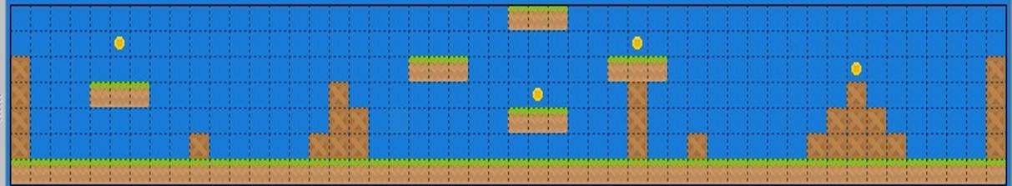
8.Map creation and Addition
I want to show you our Level 1 map of our Prototype 1.It’s from resources of Arcade Library.
9.Character animation & definition

Slide 8
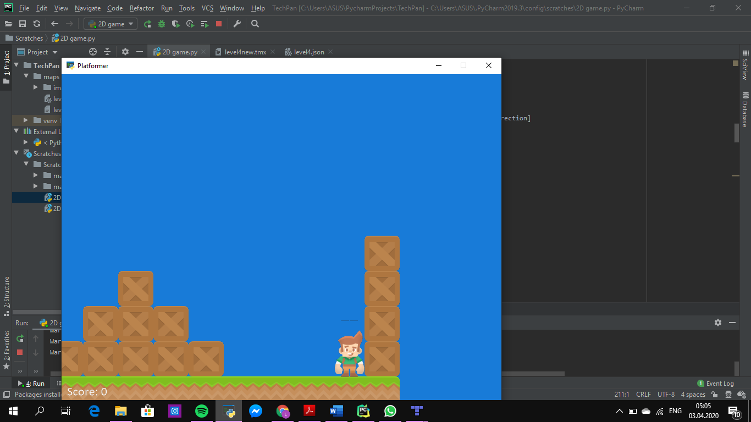
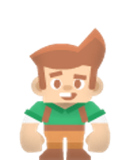
As you all can see this was the runned version of Prototype-1.
We can see the image of our character

Slide 9
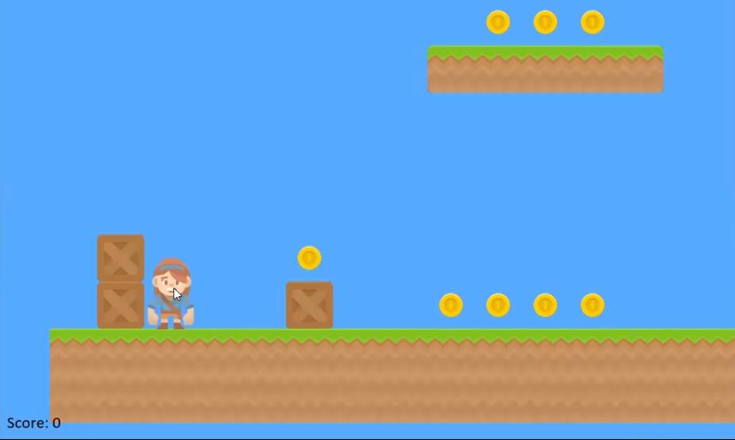
Prototype -2
In second prototype I’ve achieved to add a few more things like levels, different objects and etc.
Here you can see the runned version of Level 1.

Slide 10
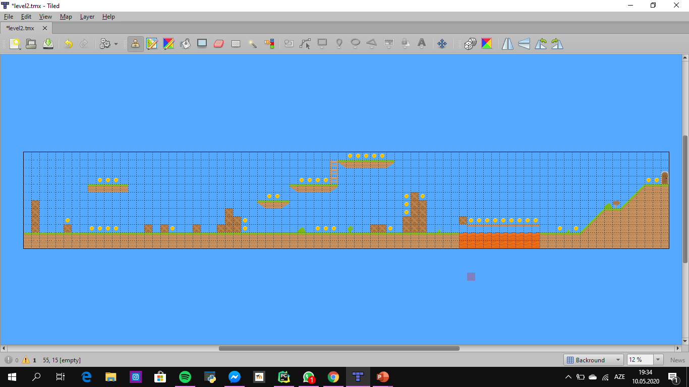
And this is the map that I used for level 1 in Prototype-2. I’ve created this by using “Tiled” map editor.

Slide 11
And this is the map that I used for level 2 in Prototype-2.

Slide 12
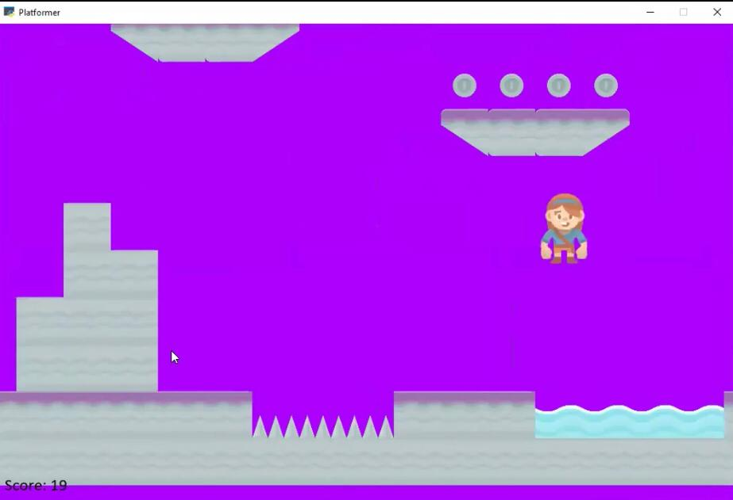
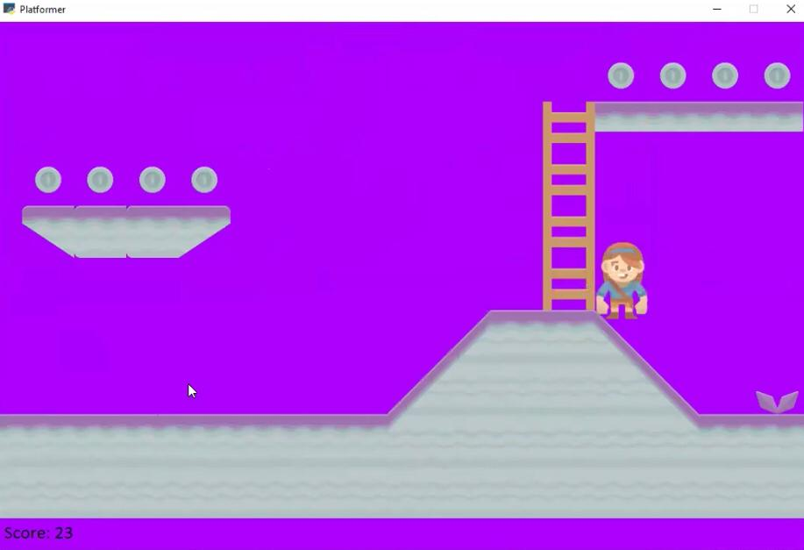
Here you can see some photos from Level-2.

Slide 13
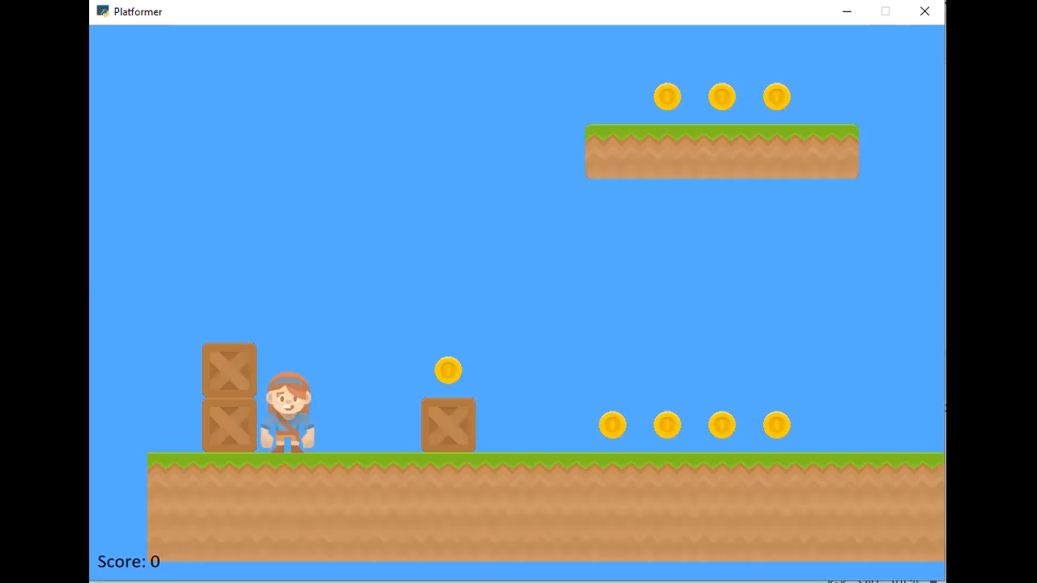
Short demo of Prototype-2.

Slide 14
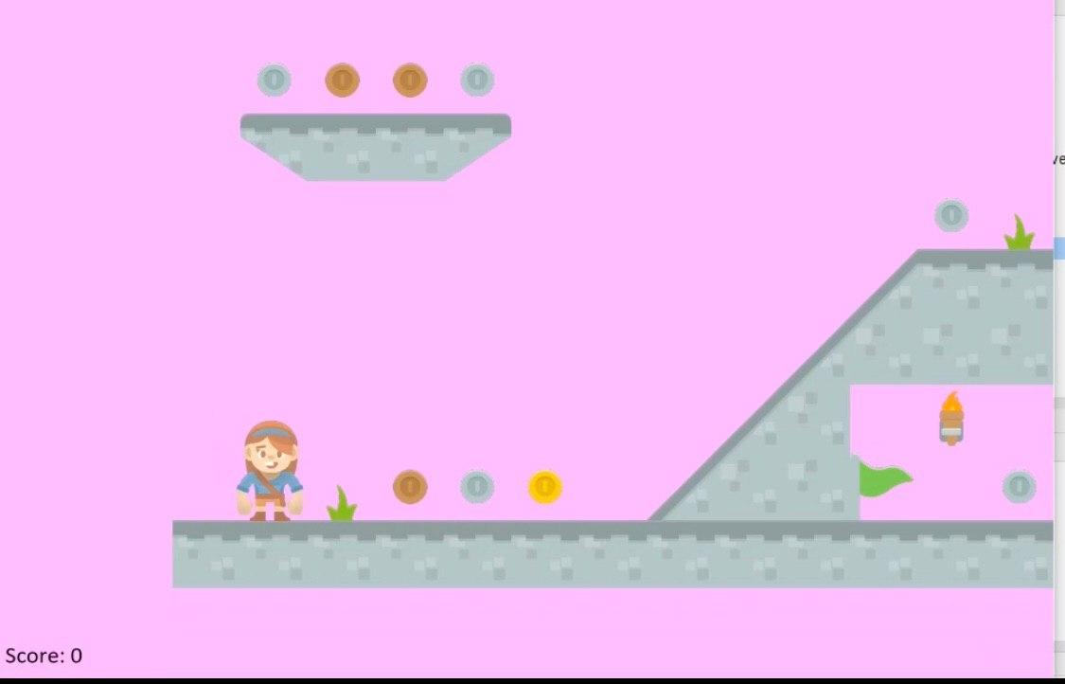
Final Product
Final product includes 3 levels. In Level 3 I achieved to add moving platforms.Also I added animated objects like flags.
Screenshot of Level 3:

Slide 15
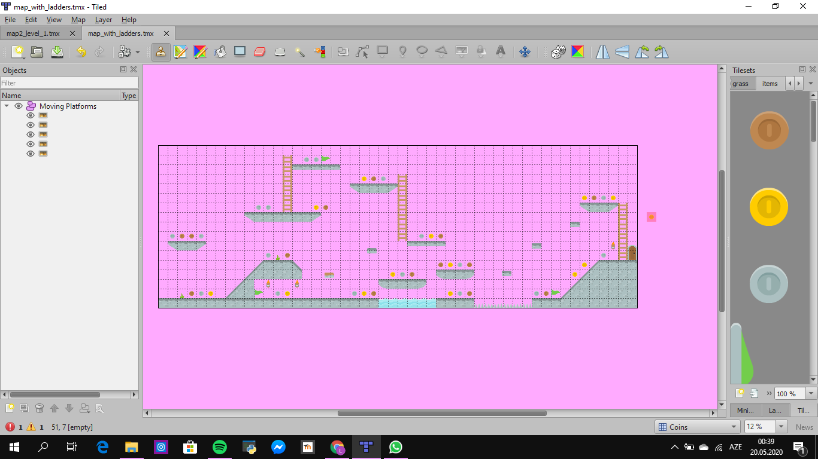
And this is the map that I used for level 3.

Slide 16
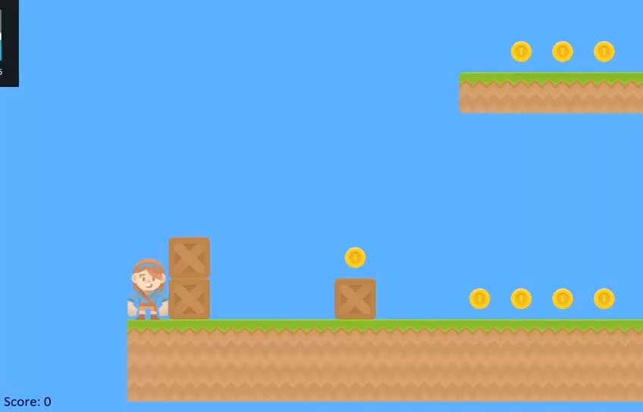
Final product demo:

Slide 17
What was new in Final Product?
Level 3
Moving Platforms
Moving objects
Level and other layer addition
New map design
New tile objects
New don’t touch part

Slide 18
Future work:
I'll believe that in future,I'll able to create more professional and advanced games.But personally I enjoyed from this project so much.I’ve learned a lot of things from this course.I’ll definetely will make a game in the future.
Game industry is changing and increasing day by day.I personally think it’s a big chance to improve ourselves in this.

Slide 19
References&Resources
Mostly I used “arcade.academy”.
From Youtube we watched a plenty of videos from channel called “Tech with Tim”, ”DaFluffyPotato”, “Professor Craven” and etc.
http://programarcadegames.com/
https://www.pygame.org/

Slide 20
Thanks for listening!

